Slide 1
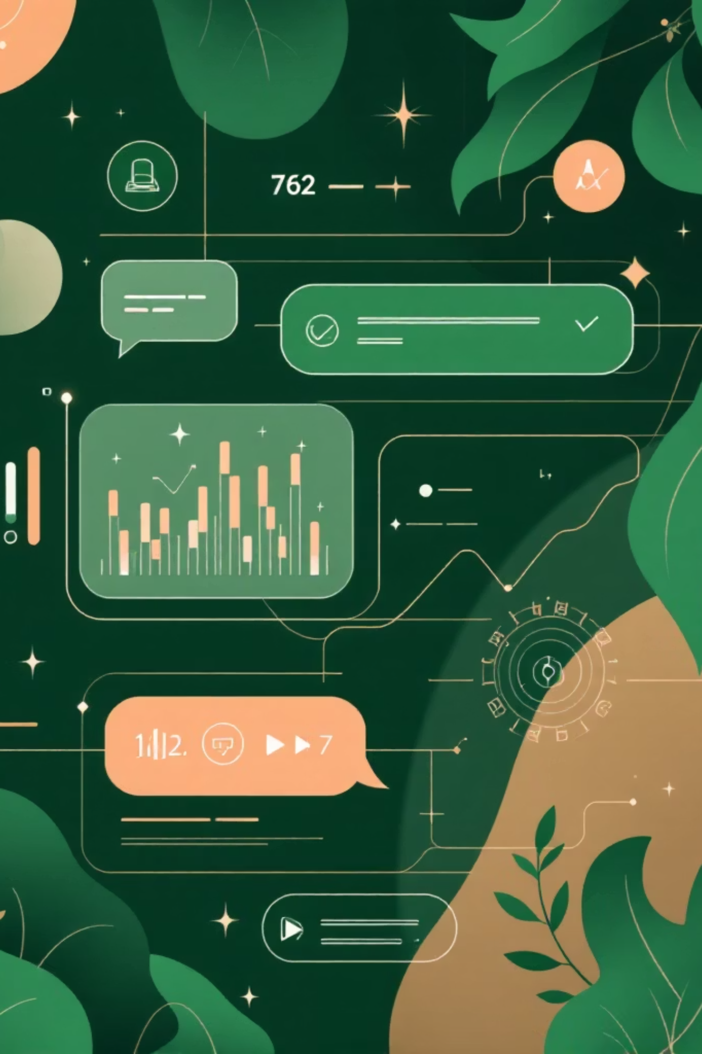
Building an IBM Watson Chatbot for Book Recommendations
Revolutionizing book discovery with AI-powered personalized suggestions.

Slide 2

About Me
I'm a passionate developer with a deep interest in artificial intelligence, conversational agents, and creating seamless user experiences. My expertise lies in leveraging modern technologies to build innovative solutions.
Developer: Ritesh Lingwal
Focus: AI, Chatbots, UX Design
Tools: IBM Watson Assistant, Docker, Git

Slide 3

PROJECT VISION
An Intelligent Guide for Readers
AI-Powered Chatbot
Personalized Recommendations
Intuitive Conversations
Developed using IBM Watson Assistant for advanced natural language processing.
Suggests books tailored to individual preferences across diverse genres.
Designed to handle vague inputs and adapt dynamically for a smooth user experience.

Slide 4
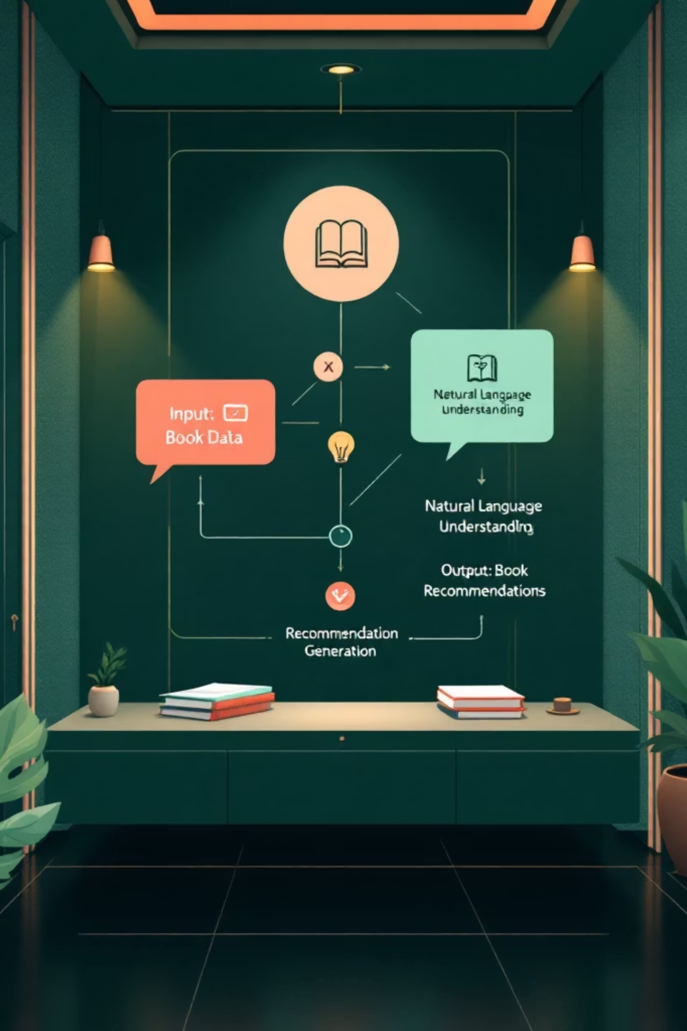
The Brain Behind the Books
Our chatbot harnesses the power of IBM Watson's advanced AI to understand user preferences and deliver spot-on book suggestions.
Natural Language Understanding
Diverse Genre Support
Context-Aware Engagement
Recommends books from Mystery, Thriller, Sci-Fi, Fantasy, and many more categories.
Maintains conversational context for more relevant and engaging interactions.
Interprets user queries, even vague ones, to grasp their reading interests.

Slide 5
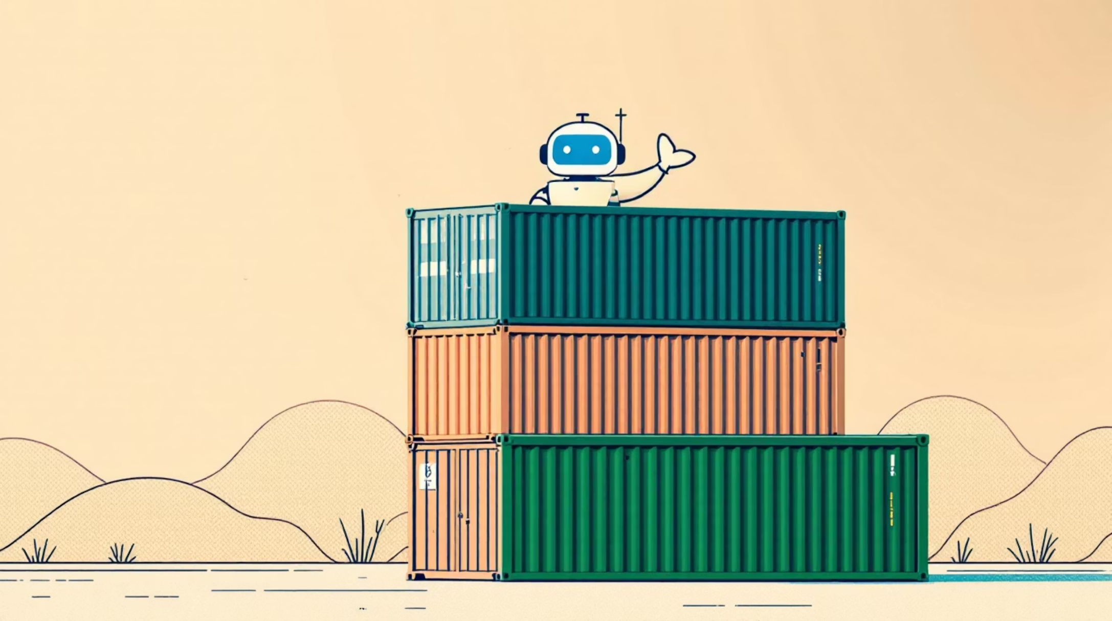
Containerizing for Consistency: Docker
To ensure seamless deployment and consistent performance across various environments, the chatbot application was packaged into a Docker container. This approach encapsulates all dependencies and configurations, making the application highly portable.
Easy Deployment: Deploy with a single command.
Consistent Environment: Eliminates "it works on my machine" issues.
Scalability: Effortlessly scale the application as demand grows.

Slide 6
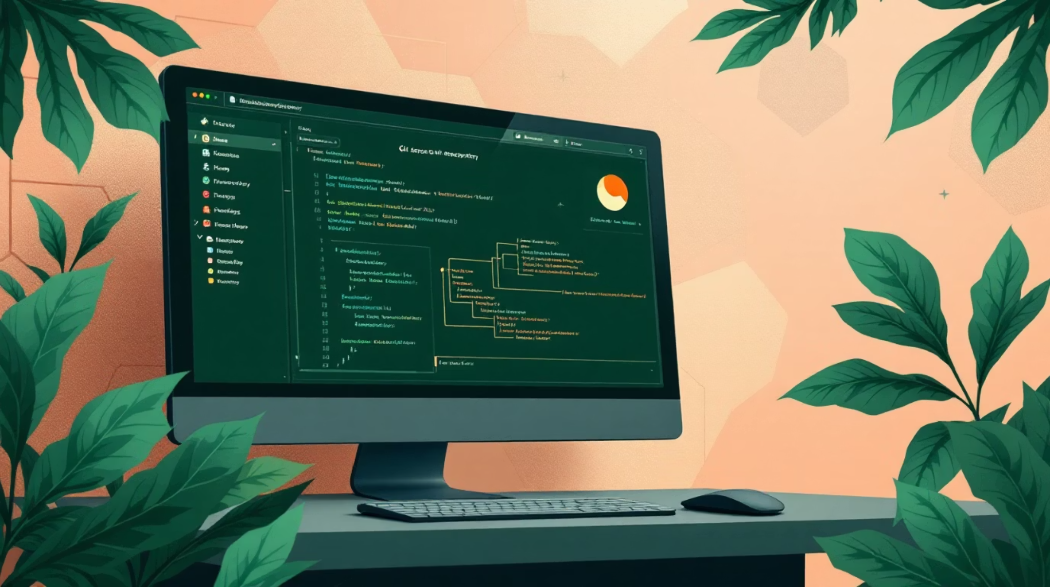
Ensuring Code Integrity: Version Control with Git
The entire project repository, including the chatbot code and Docker configurations, is hosted on GitHub. This provides robust version control and facilitates collaborative development.
Collaboration: Streamlined teamwork and code sharing.
Version History: Track all changes and revert if needed.
CI/CD Integration: Supports continuous integration and deployment pipelines.

Slide 7

From Concept to Cloud: Deployment Workflow
Develop Chatbot
Push to GitHub
Build and test recommendation logic
Commit code and push repository
Containerize
Deploy Image
Package app with Dockerfile
Run Docker image in cloud
This workflow ensures a robust, repeatable, and efficient process for developing, packaging, and deploying the book recommendation chatbot.

Slide 8
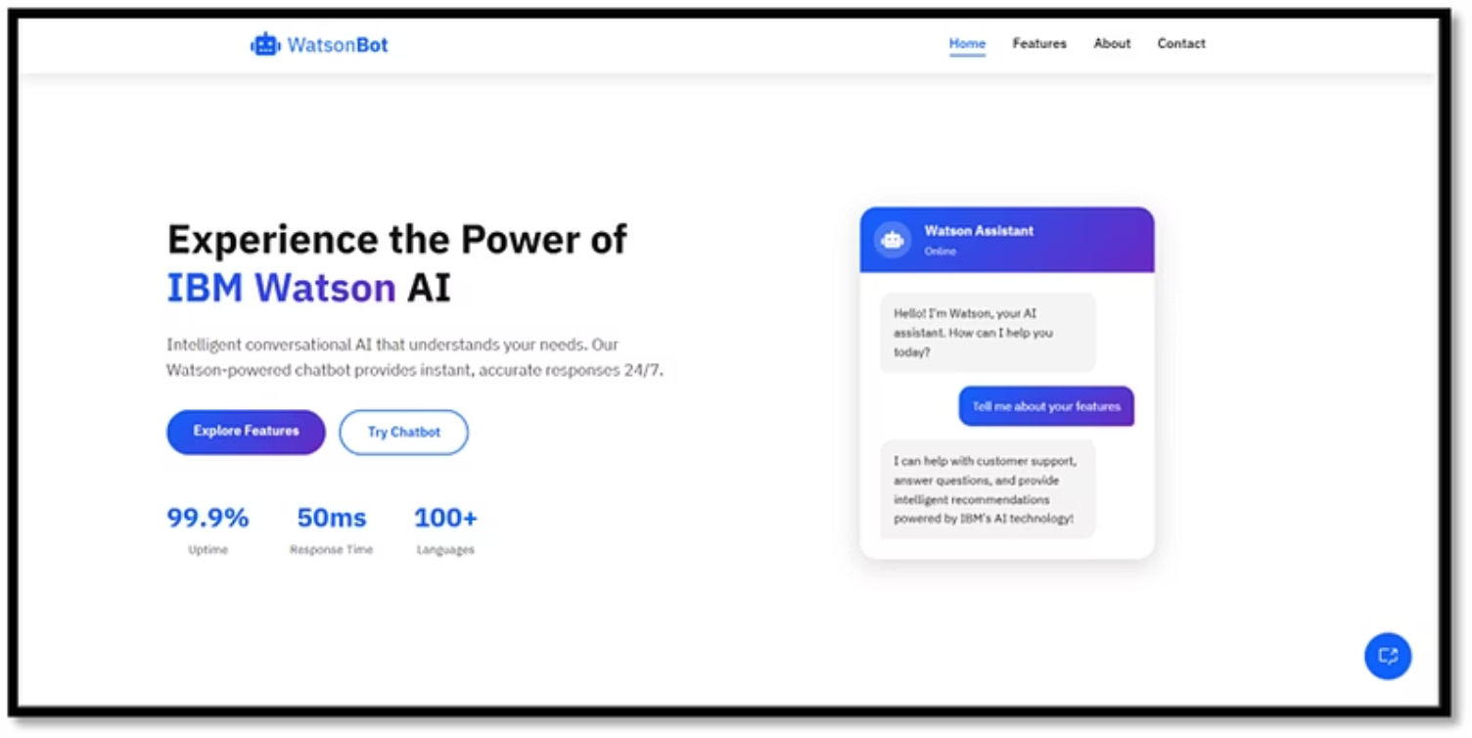
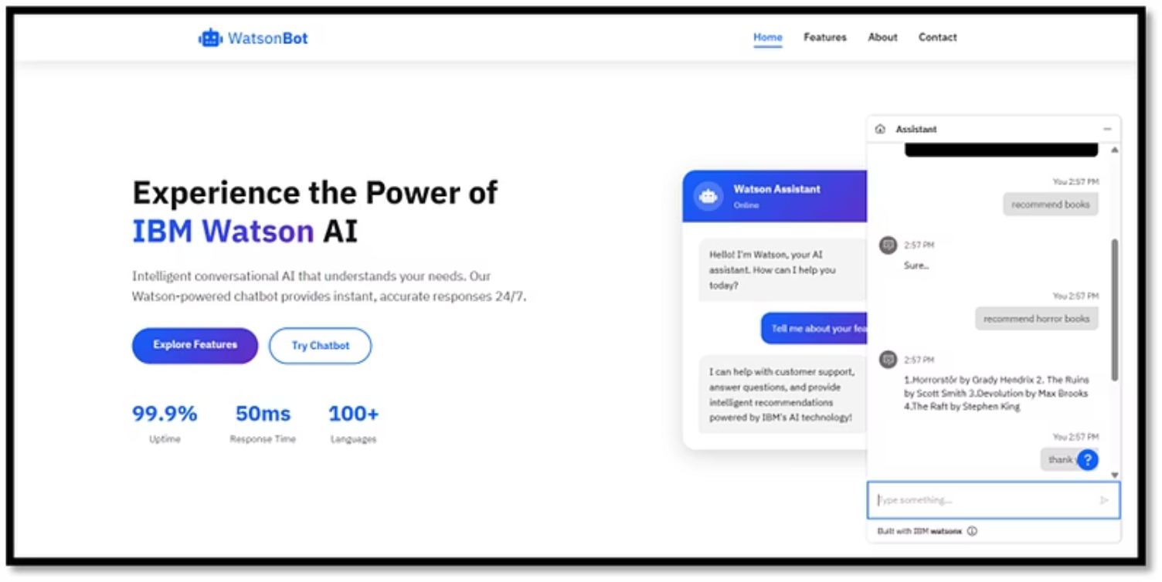
Visual Showcase: Website & Chatbot Interaction
Explore the user interface and how the chatbot engages with users to provide personalized book recommendations.

Slide 9

Thank You!
I appreciate your time and interest in this project. Feel free to reach out with any questions or explore the code further.
Questions & Discussion: I'm ready for your insights!
Contact: riteshlingwal123@gmail.com
Explore the project: https://github.com/Riteshh20/IBM-Final-Project

